Slide 1
Parallel and Distributed Computing
CS3006
Lecture 13
Basic Communication Operations-III

Slide 2
All-Reduce

Slide 3
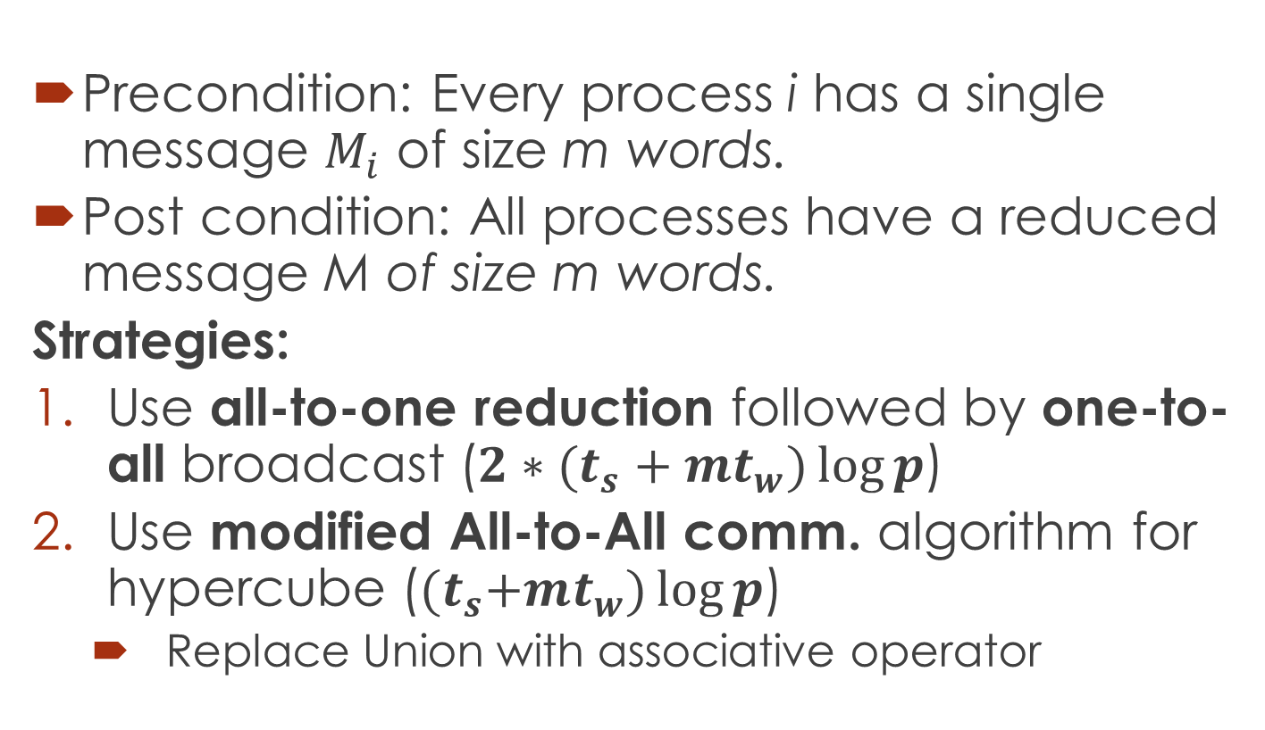
Basic Communication Operations (All-Reduce)
Precondition: Every process i has a single message $M_{i}$ of size m words.
Post condition: All processes have a reduced message M of size m words.
Strategies:
Use all-to-one reduction followed by one-to-all broadcast (${2∗(t}_{s}+mt_{w})\log{p}$)
Use modified All-to-All comm. algorithm for hypercube (${(t}_{s}+mt_{w})\log{p}$)
Replace Union with associative operator
Notes:
Barrier synchronization

Slide 4
Prefix-Sum

Slide 5
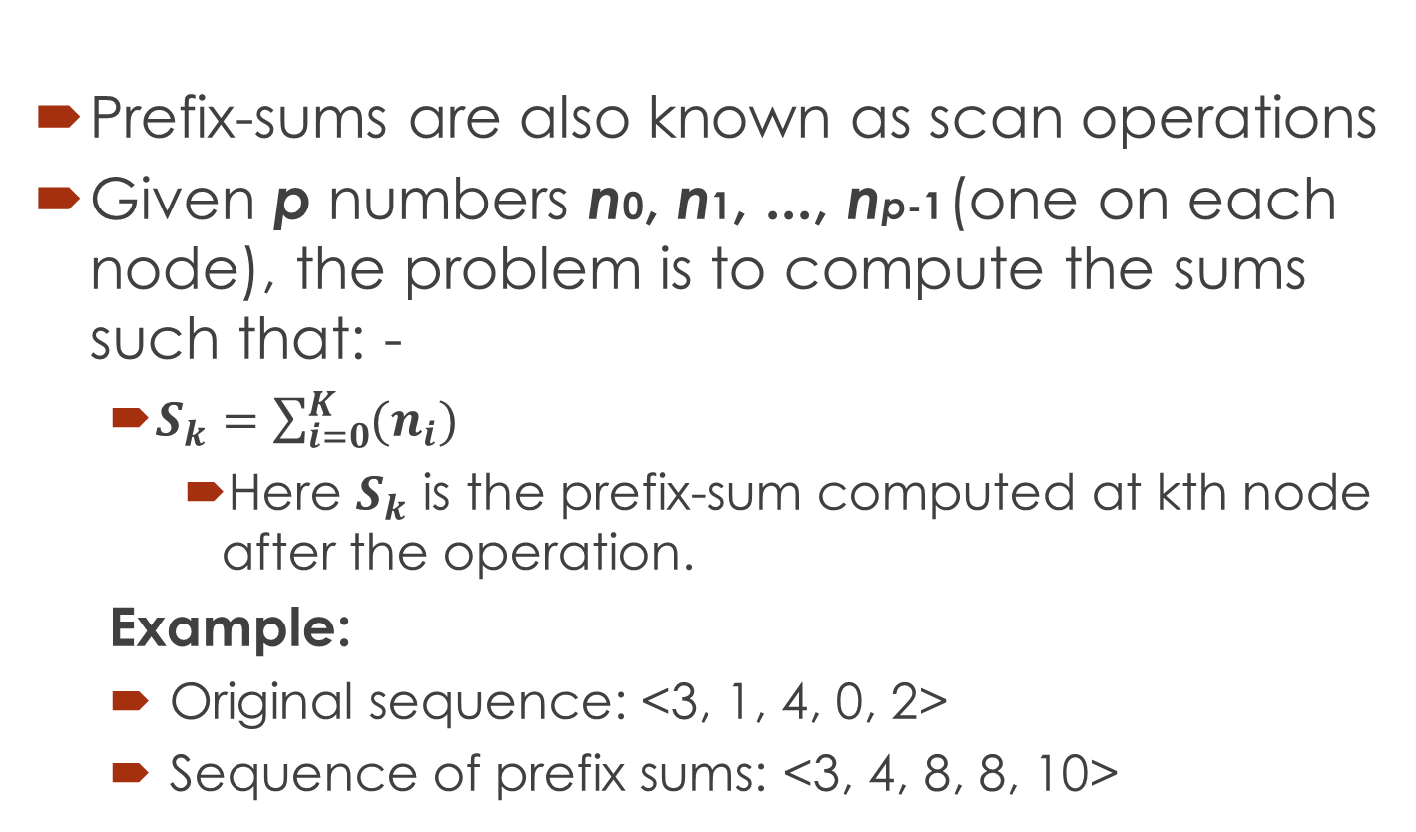
Basic Communication Operations (Prefix-Sums)
Prefix-sums are also known as scan operations
Given p numbers n0, n1, ..., np-1 (one on each node), the problem is to compute the sums such that: -
$S_{k}=\sum_{i=0}^{K}{(n_{i})}$
Here $S_{k}$ is the prefix-sum computed at kth node after the operation.
Example:
Original sequence: <3, 1, 4, 0, 2>
Sequence of prefix sums: <3, 4, 8, 8, 10>
Notes:
Applications in DNA sequence alignment and dynamic programming-based problems

Slide 6
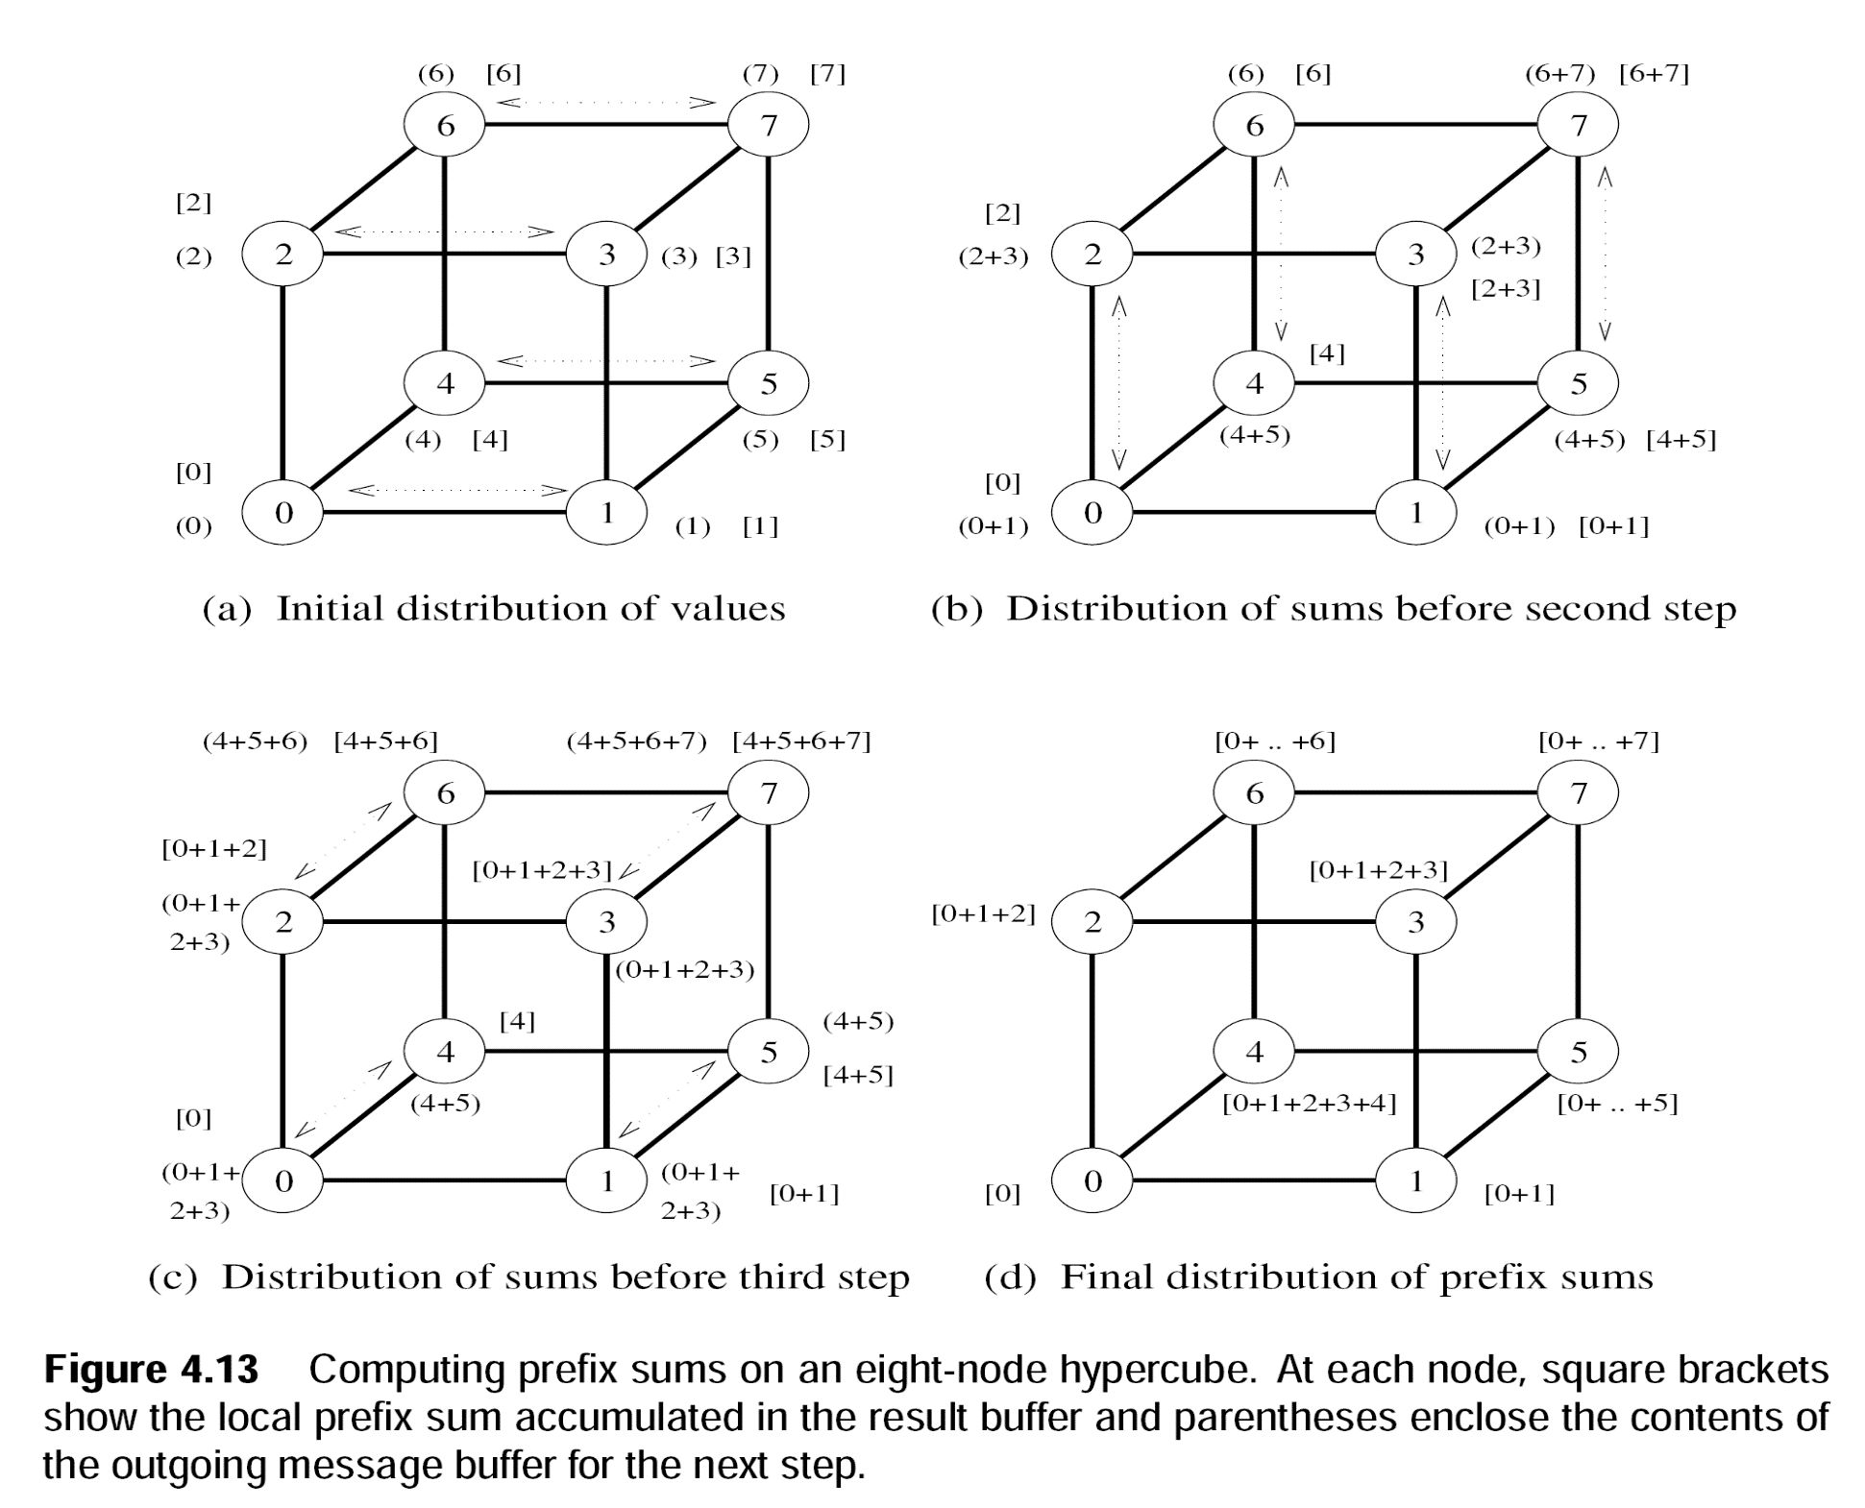
Basic Communication Operations (Prefix-Sums)
Notes:
Communication cost is same as one-to-all broadcast

Slide 7
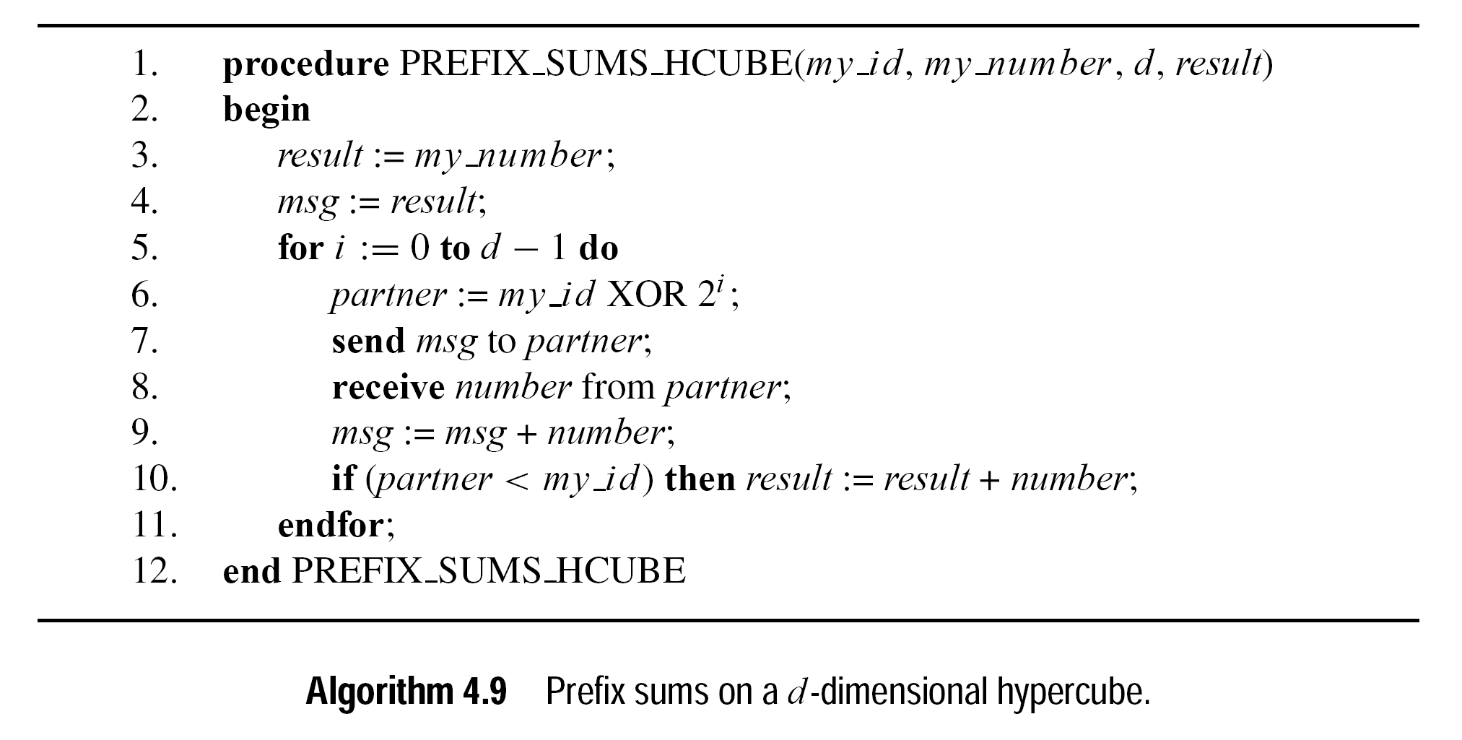
Basic Communication Operations (Prefix-Sums)
Notes:
MY_NUMBER: my initial value; msg serves as a buffer with parathesis ( )
Result buffer: serve as a buffer shown by square brackets in the figure [ ]

Slide 8
Scatter and Gather

Slide 9
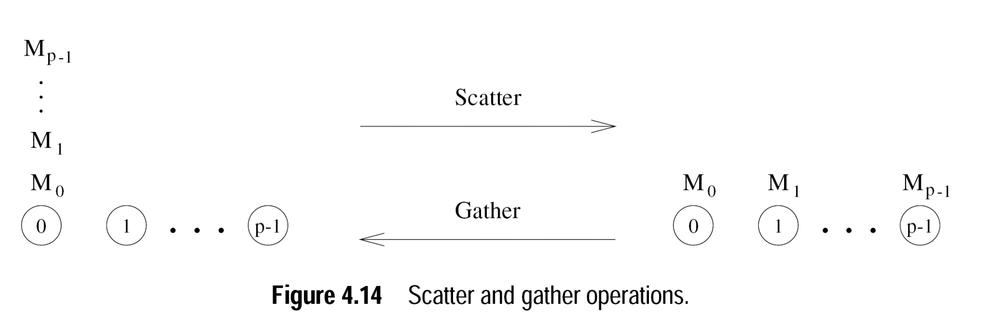
Basic Communication Operations (Scatter and Gather)
Gather is different than reduction as it doesn’t reduce the results with associative operator

Slide 10
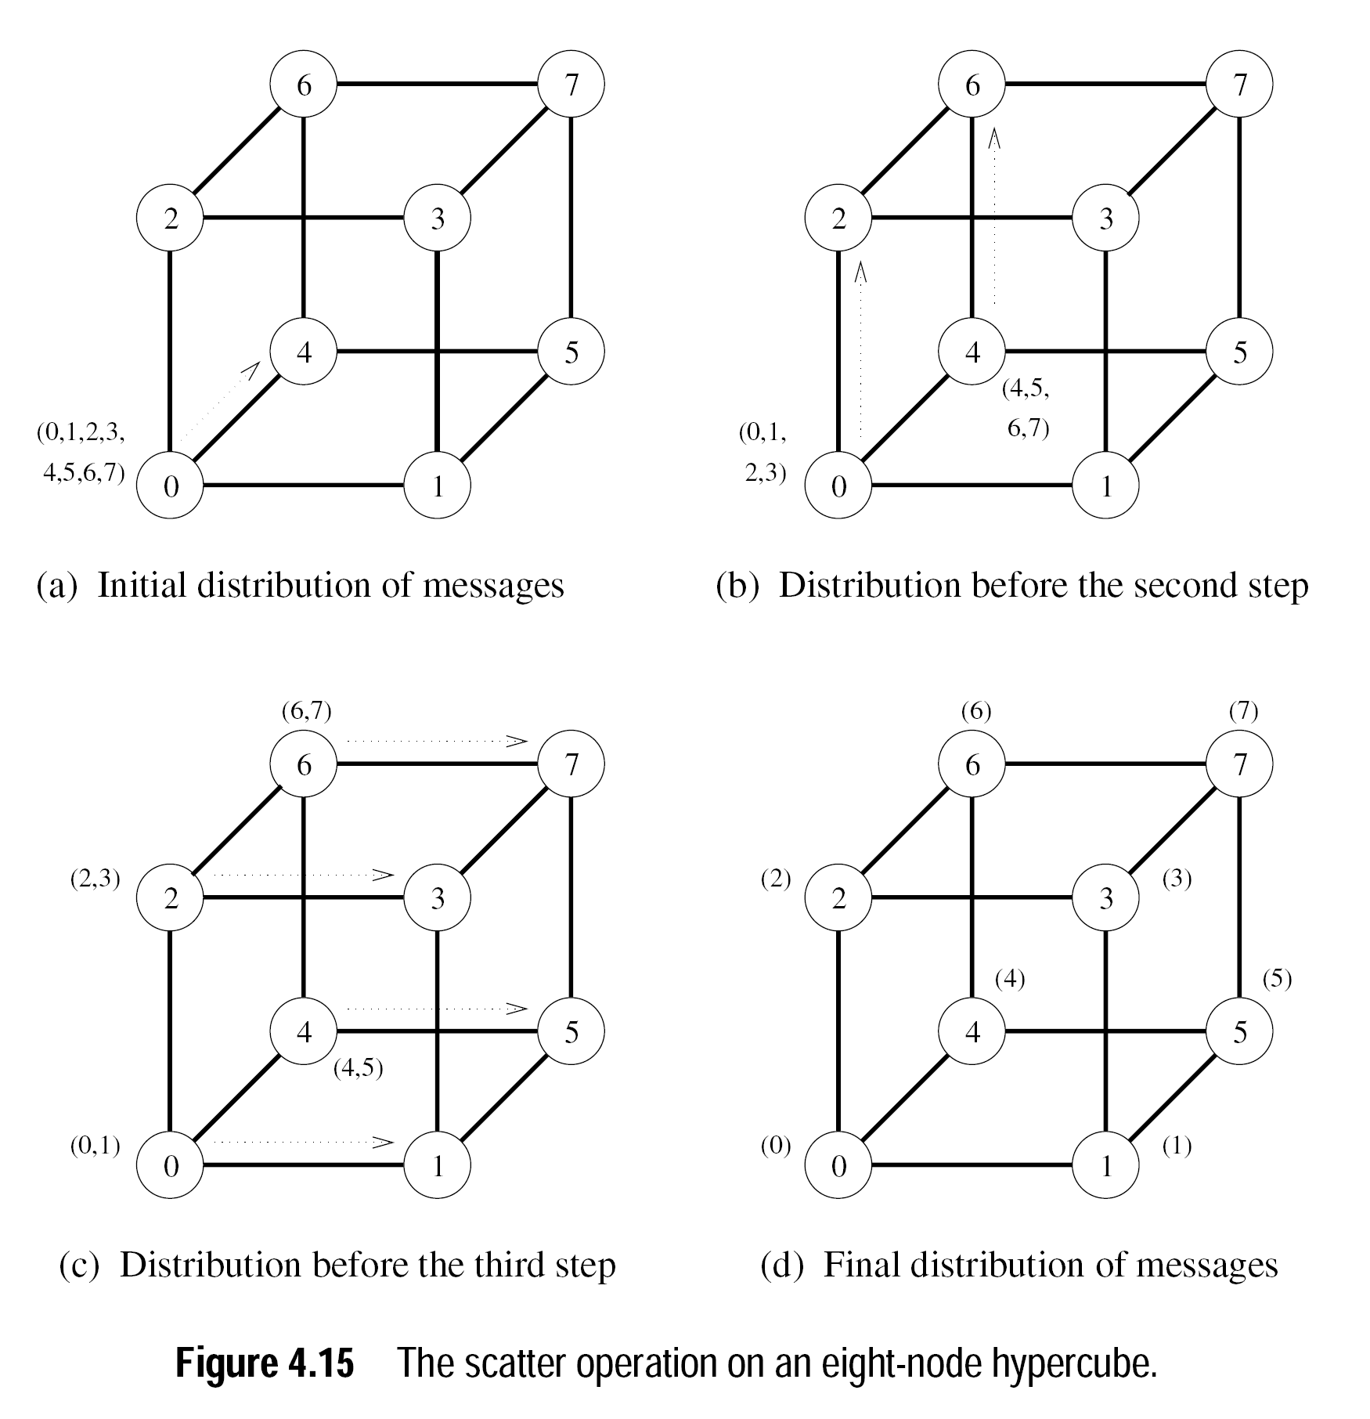
Basic Communication Operations (Scatter and Gather)
Notes:
Cost is same as All-to-All broadcast: Total Cost= $\sum_{i=1}^{log(p)}{{(t}_{s}+2^{i−1}mt_{w})}$
Answer ${T=(t}_{s}\log{p}+mt_{w}(p−1))$

Slide 11
All-to-All personalized Communication

Slide 12
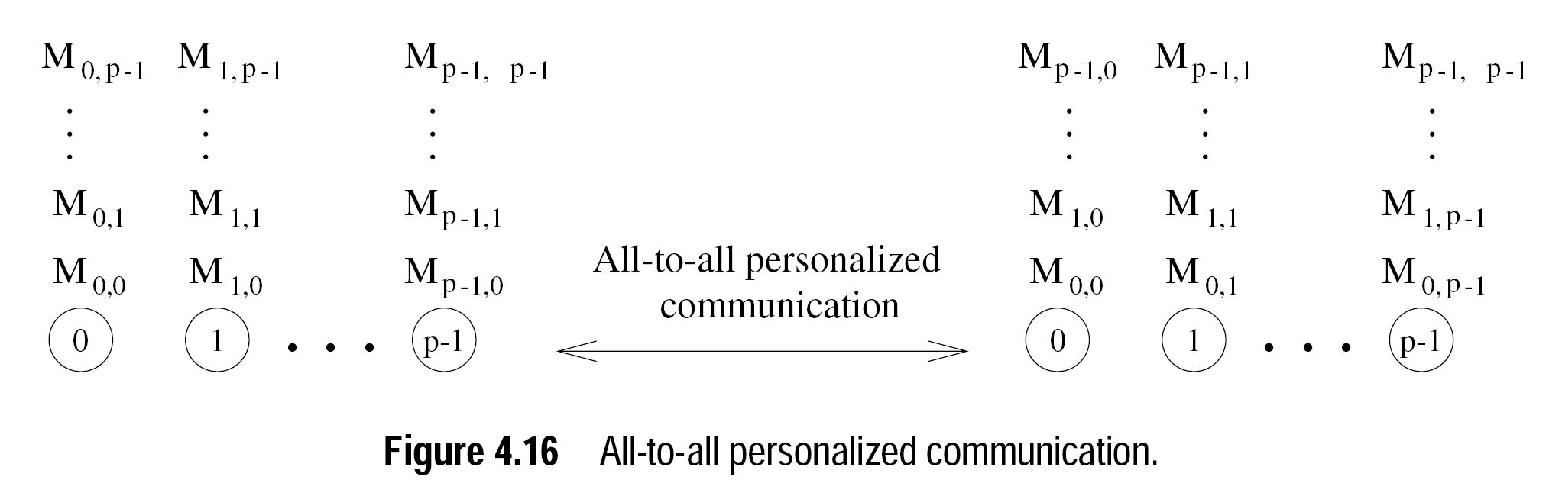
Basic Communication Operations (All-to-All personalized)
Each node sends a distinct message of size m to every other node.
Also known total exchange
Notes:
Usually used for distributed matrix transpositions, Fourier transformations and Sample sort [last step]

Slide 13
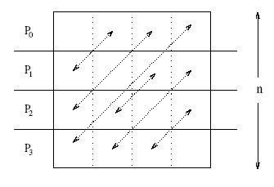
Basic Communication Operations (All-to-All personalized)
All-to-all personalized communication in transposing a 4 x 4 matrix using four processes.
Notes:
Usually used for distributed matrix transpositions.

Slide 14
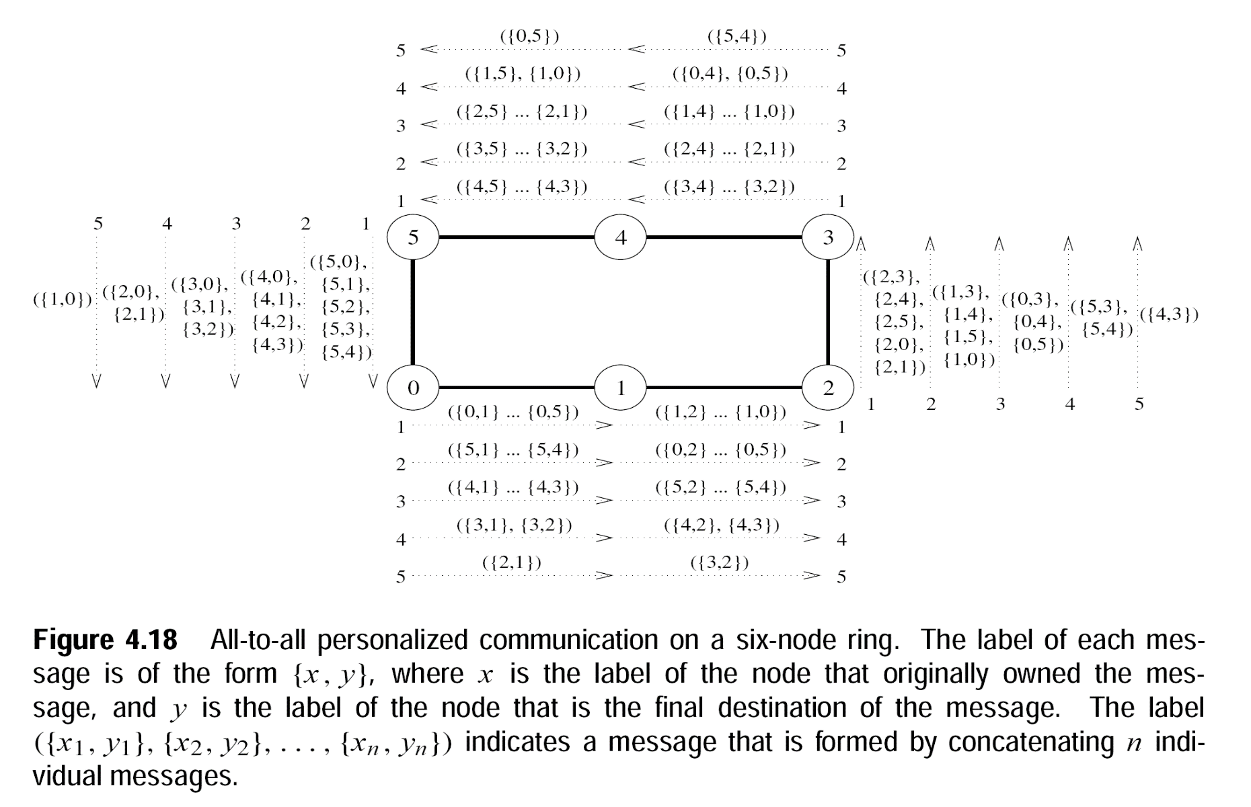
Basic Communication Operations (All-to-All personalized [Ring])

Slide 15

Basic Communication Operations (All-to-All personalized [Ring])
Cost Analysis
$T=\sum_{i=1}^{(p−1)}{{(t}_{s}+(p−i)mt_{w})}$
=$\sum_{i=1}^{(p−1)}{{(t}_{s})+ mt_{w}\sum_{i=1}^{(p−1)}{(p−i) })}$
→ $\left(p−1\right){(t}_{s}) + mt_{w}\sum_{i=1}^{(p−1)}{(i) }$
→ $\left({(t}_{s}+\left(\frac{1}{2}\right)pmt_{w}\right)\left(p−1\right)$
Notes:
Mesh and hyper cube as reading assignment.

Slide 16
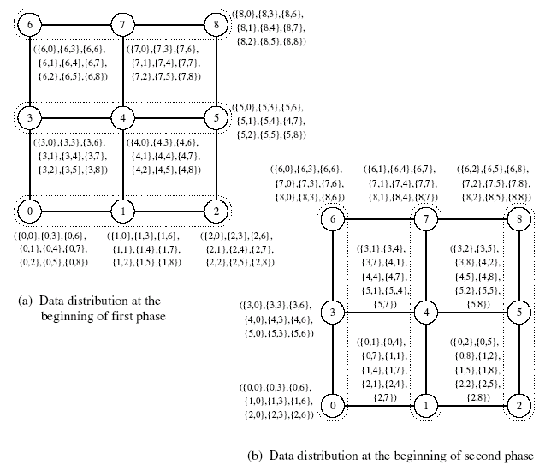
Basic Communication Operations (All-to-All personalized [Mesh])

Slide 17
Basic Communication Operations (All-to-All personalized [Mesh])
Cost Analysis
Time for the first phase is identical to that in a ring with √p processors, i.e., (t_{s} + t_{w}mp/2)(√p – 1).
Here mt_{w} becomes √p mt_{w} and P becomes √p
Time in the second phase is identical to the first phase. Therefore, total time is twice of this time, i.e.,
Notes:
Mesh and hyper cube as reading assignment.

Slide 18
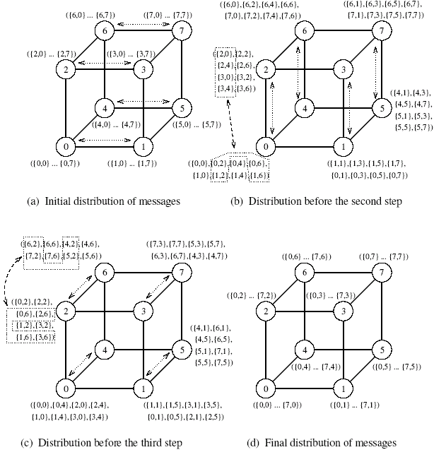
Basic Communication Operations (All-to-All personalized [Hyper Cube])

Slide 19
References
https://www.cs.purdue.edu/homes/ayg/book/Slides

